Slide 1
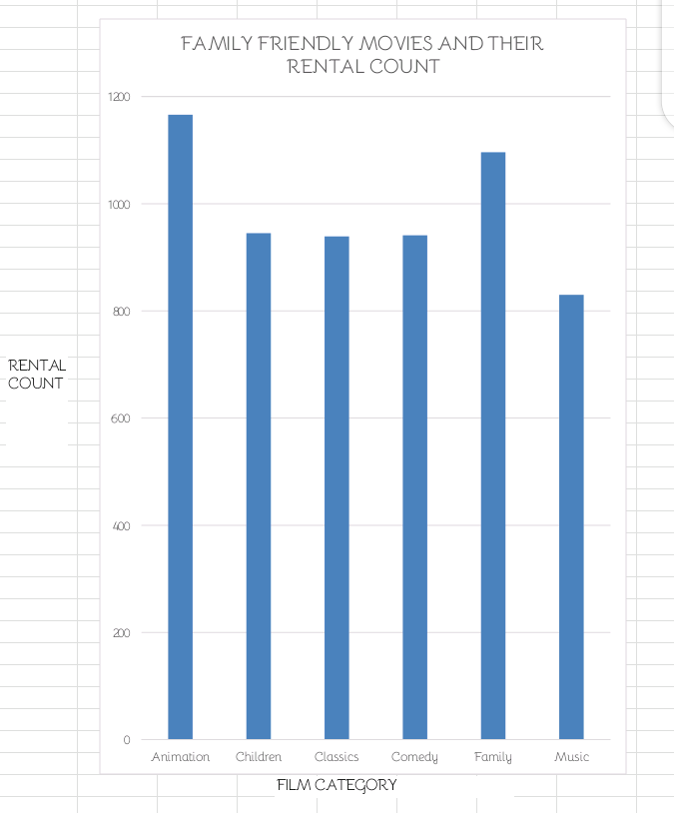
Which movies are families watching?
Here we can see that the film category watched most by families is Animation followed by Family. Children, Classics and Comedy have close rental counts. Music is the least rented by families
Query in query (1)

Slide 2
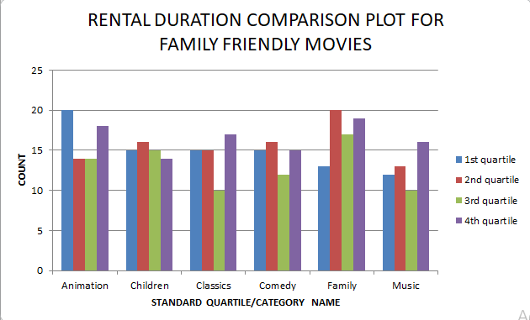
How does the Rental Duration of the family friendly movies compare to the Duration of other movies?
From the graph, we can see the counts of movies under each quartile for all categories of the family friendly movies
Query in query (2)

Slide 3
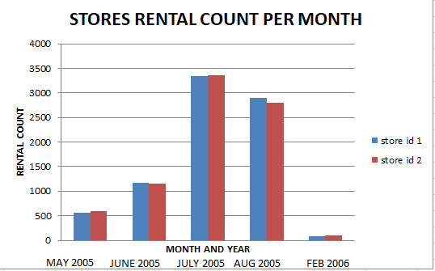
How do the two Stores compare in their Count of Rental Orders Per Month?
As seen on the chart, the two stores have close rental counts across all months
Query in query (3)

Slide 4
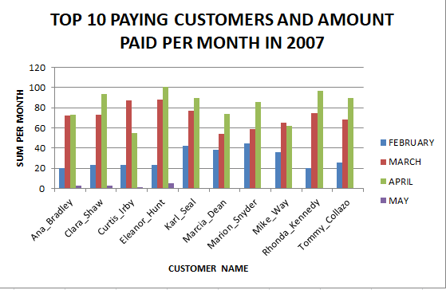
Who were our Top 10 Paying Customers in 2007? How Often and How Much did they pay Per Month?
These are the top 10 paying customers and the amount they paid per month in 2007
A click on each bar will display the pay counts per month
Query in query (4)

